Slide 1





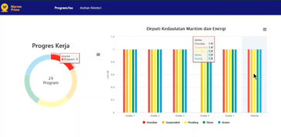
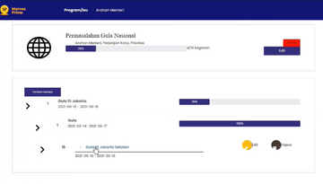
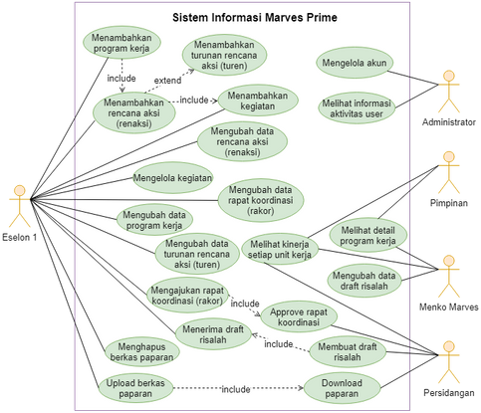







MARVES PRIME
BEST WAY TO REPORT YOUR
WORK PROGRESS
Marves Prime is a website that is used to monitor the performance and progress of each Work Program implemented by Menko Marves.
With this web application will make it easier for the coordinating minister to see the progress of each work unit in order to make decisions more efficient.
TABLES
Tables that will be used is aktivitas, catatan, file, kegiatan, notifikasi, pengguna, pimpinan, programkerja, rakor, rencanaaksi, sidang, turen and user.
MANAGE WORK PROGRAMS
NOTIFICATION
Notification consists of reminders, a list of proposed coordination meetings and notes sent from 'persidangan' user.
With derived concept, activities that will be more organized based on the above activities
VIEW PROGRESS
LOG ACTIVITIES
USER MANAGEMENT
The dashboard will be displayed for each echelon making it easier to see the conditions of the work program.
The activity history of each user will be displayed to avoid mistakes
Administrators will be able to manage users such as create a new user, changing passwords and others.
Created by:
Team: psi-2021ge-01
Faculty: Fakultas Informatika dan Teknik Elektro (FITE)
Major: Information System
Marves Prime.

